Slide 1


Accenture Data
Visualization and Story Telling
Task 3
Social
Buzz

Slide 2


Today's agenda
Project recap
Problem
The Analytics team
Process
Insights
Summary

Slide 3

Social Buzz is a fast growing technology unicorn that need to adapt quickly to it's global scale. Accenture has begun a 3 month POC focusing on these tasks:
An audit of Social Buzz's big data practice.
Recommendations for a successful IPO.
Analysis to find Social Buzz's top 5 most popular categories of content
Project Recap

Slide 4

Problem
Over 100000 posts per day
36,500,000 pieces of content per year!
But how to capitalize on it when there is so much?
Analysis to find Social Buzz's top 5 most popular categories of content

Slide 5
Aditi Shekhawat Data Analyst
The Analytics team
Marcus Rompton Senior Principle
Andrew Flamming Chief Technical Architect

Slide 6
1
Data Understanding
2
Data Cleaning
Process
3
Data Modelling
4
Data Analysis
5
Uncover Insights

Slide 7

Animal
Most Favorite Categories
May
With Most Number of Post
16
Unique Categories

Slide 8
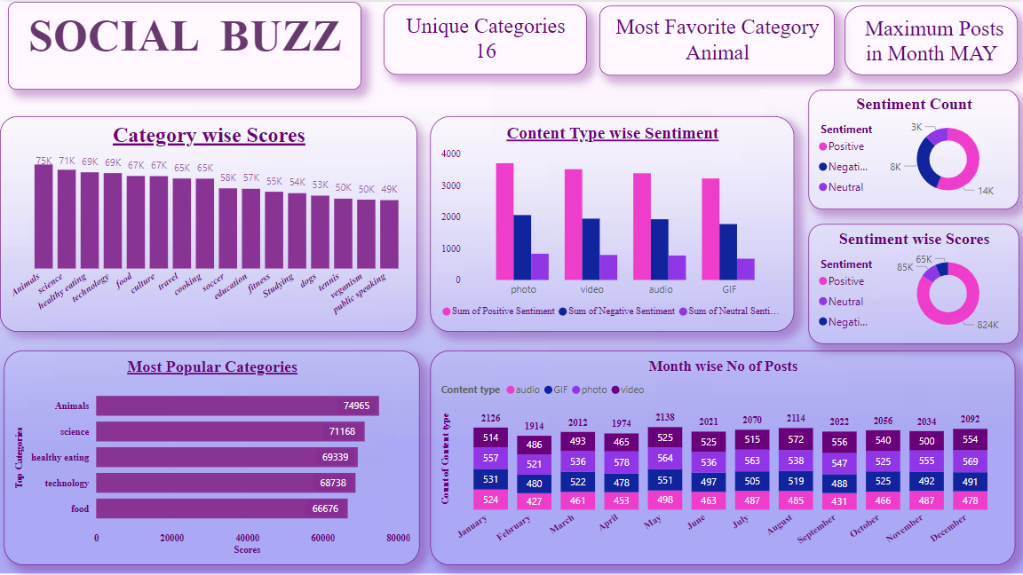
VISUALISATION

Slide 9

There are a total of 16 distinct content categories. Out of which Animal and Science categories are the most popular one.
4 types of content- Photo, Video, GIF and Audio, out of which people prefer photo and video the most.
May month has the highest number of posts and stands at 2138 posts, while February month has the lowest number of posts (1914 Posts)
Conclusion
Social Buzz should focus more on the top 5 categories that's Animal, Technology, Science, Healthy eating and food and can create campaign to specifically target those audiences.
Social Buzz can need to maximize in the month of January, May and August as they number of posts in these months are the highest.
Summary

Slide 10
Thank you!
ANY QUESTIONS?

